Slide 1

PowerPoint Lectures for
Principles of Microeconomics, 9e
By
Karl E. Case,
Ray C. Fair &
Sharon M. Oster
; ;

Slide 2


Slide 3
Input Demand:
The Capital Market and
the Investment Decision
Prepared by:
Fernando & Yvonn Quijano

Slide 4


Input Demand:
The Capital Market and
the Investment Decision
PART II THE MARKET SYSTEM
Choices Made by Households and Firms
11
CHAPTER OUTLINE
Capital, Investment, and Depreciation
Capital
Investment and Depreciation
The Capital Market
Capital Income: Interest and Profits
Financial Markets in Action
Mortgages and the Mortgage Market
Capital Accumulation and Allocation
The Demand for New Capital and the Investment Decision
Forming Expectations
Comparing Costs and Expected Return
A Final Word on Capital
Appendix: Calculating Present Value

Slide 5
Capital, Investment, and Depreciation
Capital
capital Those goods produced by the economic system that are used as inputs to produce other goods and services in the future.
Tangible Capital
physical, or tangible, capital Material things used as inputs in the production of future goods and services. The major categories of physical capital are nonresidential structures, durable equipment, residential structures, and inventories.

Slide 6
Capital, Investment, and Depreciation
Capital
Social Capital: Infrastructure
social capital, or infrastructure Capital that provides services to the public. Most social capital takes the form of public works (roads and bridges) and public services (police and fire protection).

Slide 7
Capital, Investment, and Depreciation
Capital
Intangible Capital
intangible capital Nonmaterial things that contribute to the output of future goods and services.
human capital A form of intangible capital that includes the skills and other knowledge that workers have or acquire through education and training and that yields valuable services to a firm over time.

Slide 8
Capital, Investment, and Depreciation
Capital
The Time Dimension
The value of capital is only as great as the value of the services it will render over time.
Measuring Capital
capital stock For a single firm, the current market value of the firm’s plant, equipment, inventories, and intangible assets.

Slide 9

Which of the following is the best measure of the capital stock of a business firm?
a. Book value, or the value of the company on its books.
b. Historic value, or the trend in value added to a company over its history.
c. Current market value, or the value of company’s capital stock in the market today.
d. All of the above are equally accurate measures of the capital stock of a business firm.

Slide 10
Which of the following is the best measure of the capital stock of a business firm?
a. Book value, or the value of the company on its books.
b. Historic value, or the trend in value added to a company over its history.
c. Current market value, or the value of company’s capital stock in the market today.
d. All of the above are equally accurate measures of the capital stock of a business firm.

Slide 11
Capital, Investment, and Depreciation
Investment and Depreciation
investment New capital additions to a firm’s capital stock. Although capital is measured at a given point in time (a stock), investment is measured over a period of time (a flow). The flow of investment increases the capital stock.
depreciation The decline in an asset’s economic value over time.

Slide 12
Capital, Investment, and Depreciation
Investment and Depreciation
TABLE 11.1 Private Investment in the U.S. Economy, 2007
GDP = 13,769 Gross private domestic investment = 2,139.0
 |  | Billions of Current Dollars |  |  |  |  | As a Percentage of Total Gross Investment |  |  |  | As a Percentage of GDP
Nonresidential structures |  |  | 464.5 |  |  |  |  | 21.7 |  |  |  |  | 3.4
Equipment and software |  |  | 1004.5 |  |  |  |  | 47.0 |  |  |  |  | 7.3
Change in private inventories |  |  | 5.1 |  |  |  |  | 0.2 |  |  |  |  | 0
Residential structures |  |  | 664.8 |  |  |  |  | 31.1 |  |  |  |  | 4.8
Total gross private investment |  |  | 2139.0 |  |  |  |  | 100.0 |  |  |  |  | 15.5
− depreciation |  |  | − 1683.4 |  |  |  |  | − 78.7 |  |  |  |  | − 12.2
Net investment = gross investment − depreciation |  |  | 455.6 |  |  |  |  | 21.3 |  |  |  |  | 3.3

Slide 13
Which of the following statements is correct?
a. Net investment equals gross investment plus depreciation.
b. Gross investment minus depreciation equals net investment.
c. Capital stock at the end of last year plus gross investment this year equals capital stock at the end of this year.
d. Net investment equals depreciation.

Slide 14
Which of the following statements is correct?
a. Net investment equals gross investment plus depreciation.
b. Gross investment minus depreciation equals net investment.
c. Capital stock at the end of last year plus gross investment this year equals capital stock at the end of this year.
d. Net investment equals depreciation.

Slide 15
The Capital Market
capital market The market in which households supply their savings to firms that demand funds to buy capital goods.
bond A contract between a borrower and a lender, in which the borrower agrees to pay the loan at some time in the future, along with interest payments along the way.
financial capital market The part of the capital market in which savers and investors interact through intermediaries.

Slide 16
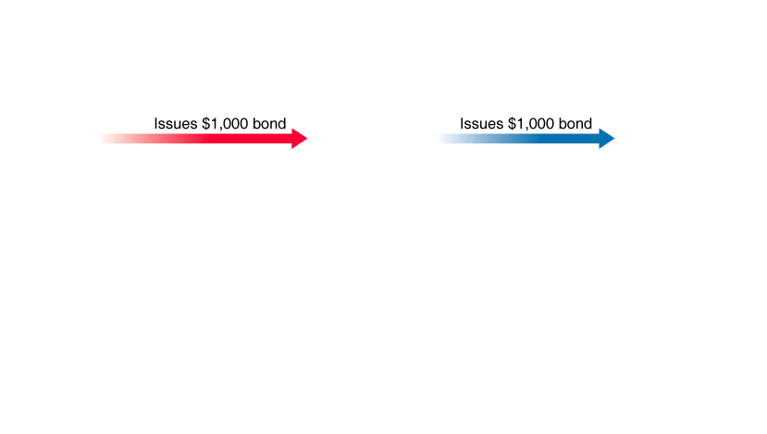
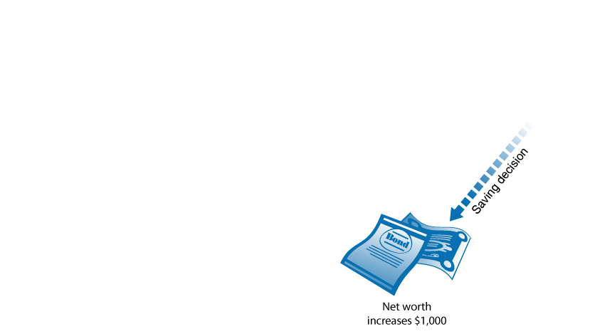
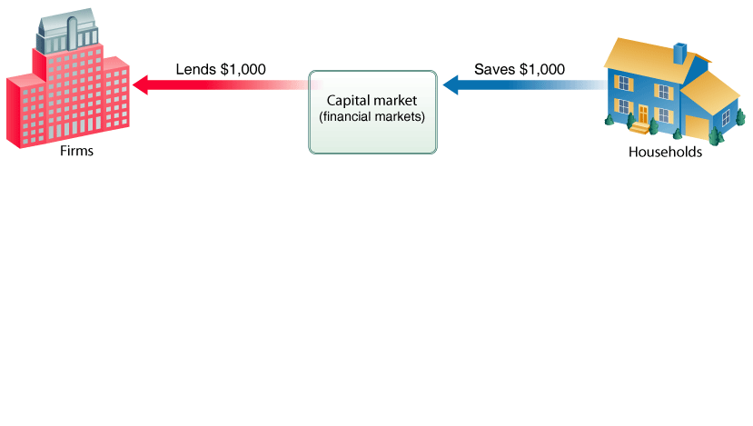
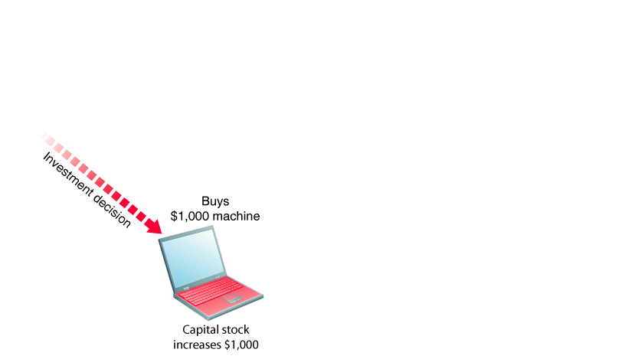
The Capital Market
① FIGURE 11.1 $1,000 in Savings Becomes $1,000 of Investment

Slide 17
Which of the following constitutes the demand for capital in the capital market?
a. Saving.
b. Depreciation.
c. Investment.
d. Financial institutions.

Slide 18
Which of the following constitutes the demand for capital in the capital market?
a. Saving.
b. Depreciation.
c. Investment.
d. Financial institutions.

Slide 19
The Capital Market
Capital Income: Interest and Profits
capital income Income earned on savings that have been put to use through financial capital markets.
Interest
interest The payments made for the use of money.
interest rate A fee paid annually expressed as a percentage of the loan or deposit.

Slide 20
How is the decision to undertake a new investment project made?
a. The decision is based on the expected depreciation schedule of the new asset.
b. The decision to undertake a new investment project is based on the relative contribution of the investment to the capital stock of the firm.
c. Projects are undertaken as long as the revenues likely to be realized from the investment are sufficient to cover the interest payments to the household.
d. The decision to undertake a new investment project is based on the ability of the firm to raise capital.

Slide 21
How is the decision to undertake a new investment project made?
a. The decision is based on the expected depreciation schedule of the new asset.
b. The decision to undertake a new investment project is based on the relative contribution of the investment to the capital stock of the firm.
c. Projects are undertaken as long as the revenues likely to be realized from the investment are sufficient to cover the interest payments to the household.
d. The decision to undertake a new investment project is based on the ability of the firm to raise capital.

Slide 22
The Capital Market
Capital Income: Interest and Profits
Profits
stock A share of stock is an ownership claim on a firm, entitling its owner to a profit share.
profit The excess of revenues over cost in a given period.
Functions of Interest and Profit
Interest may function as an incentive to postpone gratification.
Profit serves as a reward for innovation and risk taking.

Slide 23
When an entrepreneur starts a new business by buying capital with her own savings, that person is:
a. Supplying capital but not demanding capital.
b. Demanding capital but not supplying capital.
c. Both supplying and demanding capital.
d. Neither supplying nor demanding capital.

Slide 24
When an entrepreneur starts a new business by buying capital with her own savings, that person is:
a. Supplying capital but not demanding capital.
b. Demanding capital but not supplying capital.
c. Both supplying and demanding capital.
d. Neither supplying nor demanding capital.

Slide 25
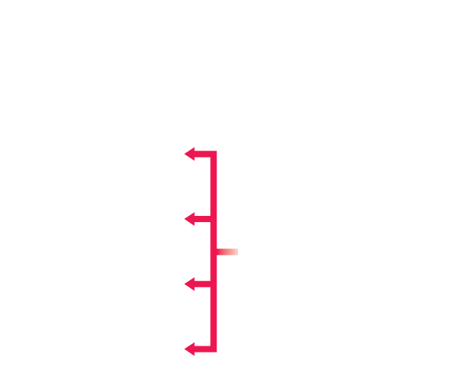


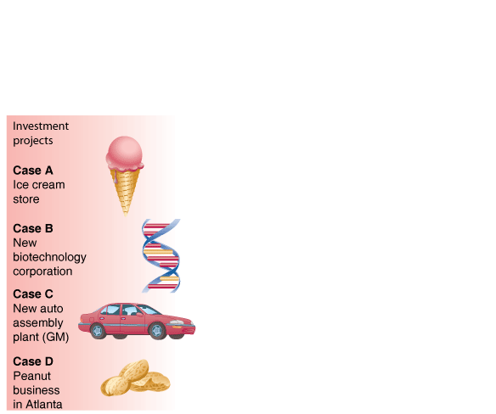

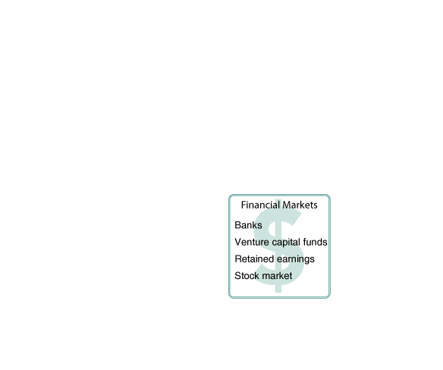
The Capital Market
Financial Markets in Action
① FIGURE 11.2 Financial Markets Link Household Saving and Investment by Firms

Slide 26
Which of the following mechanisms are used to channel household savings into investment projects?
a. Business loans
b. Venture capital
c. Retained earnings
d. The stock market
e. All of the above

Slide 27
Which of the following mechanisms are used to channel household savings into investment projects?
a. Business loans
b. Venture capital
c. Retained earnings
d. The stock market
e. All of the above

Slide 28
The Capital Market
Mortgages and the Mortgage Market
Most real estate in the United States is financed by mortgages. A mortgage, like a bond, is a contract in which the borrower promises to repay the lender in the future.
Until the last decade, most mortgage loans were made by banks and savings and loans.
In recent years, most mortgages were written by mortgage brokers or mortgage bankers who immediately sold the mortgages to a secondary market.

Slide 29
The Capital Market
Capital Accumulation and Allocation
In modern industrial societies, investment decisions (capital production decisions) are made primarily by firms. Households decide how much to save; and in the long run, savings limit or constrain the amount of investment that firms can undertake. The capital market exists to direct savings into profitable investment projects.

Slide 30
The Demand for New Capital and the Investment Decision
Firms have an incentive to expand in industries that earn positive profits—that is, a rate of return above normal—and in industries in which economies of scale lead to lower average costs at higher levels of output. Positive profits in an industry stimulate the entry of new firms. The expansion of existing firms and the creation of new firms both involve investment in new capital.

Slide 31
The Demand for New Capital and the Investment Decision
Forming Expectations
The Expected Benefits of Investments
The investment process requires that the potential investor evaluate the expected flow of future productive services that an investment project will yield.
The Expected Costs of Investments
The ability to lend at the market rate of interest means that there is an opportunity cost associated with every investment project. The evaluation process thus involves not only estimating future benefits but also comparing them with the possible alternative uses of the funds required to undertake the project. At a minimum, those funds could earn interest in financial markets.

Slide 32
Which investment projects are more likely to be funded?
a. Only those investment projects that are expected to yield a rate of return higher than the market interest rate.
b. Only those investment projects that are expected to yield a rate of return lower than the market interest rate.
c. As long as market interest rates are rising, any investment project will be funded, regardless of the market interest rate.
d. Only those investment projects that are expected to yield a rate of return exactly equal to the market interest rate.

Slide 33
Which investment projects are more likely to be funded?
a. Only those investment projects that are expected to yield a rate of return higher than the market interest rate.
b. Only those investment projects that are expected to yield a rate of return lower than the market interest rate.
c. As long as market interest rates are rising, any investment project will be funded, regardless of the market interest rate.
d. Only those investment projects that are expected to yield a rate of return exactly equal to the market interest rate.

Slide 34

The Demand for New Capital and the Investment Decision
What makes venture capital Green?
Forming Expectations
Venture Capital Goes Big for Green
The Kiplinger Letter

Slide 35
The Demand for New Capital and the Investment Decision
Comparing Costs and Expected Return
expected rate of return The annual rate of return that a firm expects to obtain through a capital investment.
The expected rate of return on an investment project depends on the price of the investment, the expected length of time the project provides additional cost savings or revenue, and the expected amount of revenue attributable each year to the project.

Slide 36
The Demand for New Capital and the Investment Decision
Comparing Costs and Expected Return
TABLE 11.2 Potential Investment Projects and Expected Rates of Return for a Hypothetical Firm, Based on Forecasts of Future Profits Attributable to the Investment
Project | (1) Total Investment (Dollars) | (2) Expected Rate Of Return (Percent)
A. New computer network | 400,000 |  | 25
B. New branch plant | 2,600,000 |  | 20
C. Sales office in another state | 1,500,000 |  | 15
D. New automated billing system | 100,000 |  | 12
E. Ten new delivery trucks | 400,000 |  | 10
F. Advertising campaign | 1,000,000 |  | 7
G. Employee cafeteria | 100,000 |  | 5

Slide 37
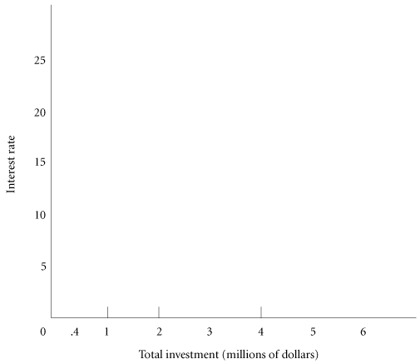














The Demand for New Capital and the Investment Decision
Comparing Costs and Expected Return
④ FIGURE 11.3 Total Investment as a Function of the Market Interest Rate
The demand for new capital depends on the interest rate. When the interest rate is low, firms are more likely to invest in new plant and equipment than when the interest rate is high. This is so because the interest rate determines the direct cost (interest on a loan) or the opportunity cost (alternative investment) of each project.

Slide 38
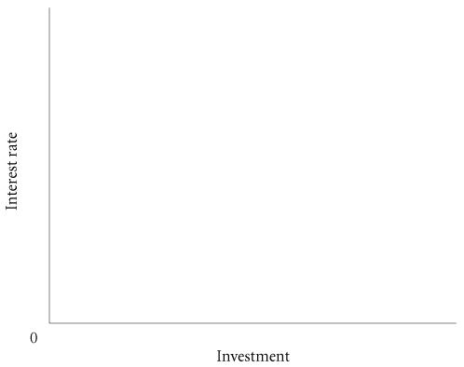
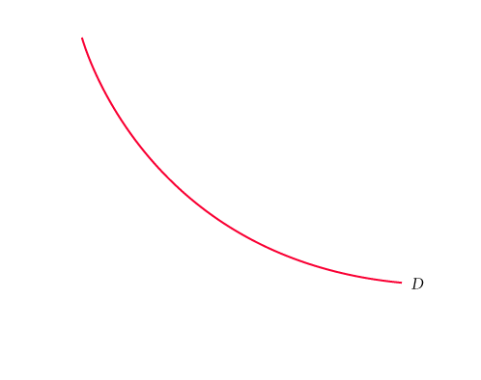
The Demand for New Capital and the Investment Decision
Comparing Costs and Expected Return
④ FIGURE 11.4 Investment Demand
Lower interest rates are likely to stimulate investment in the economy as a whole, whereas higher interest rates are likely to slow investment.

Slide 39
The Demand for New Capital and the Investment Decision
Comparing Costs and Expected Return
The Expected Rate of Return and the Marginal Revenue Product of Capital
A perfectly competitive profit-maximizing firm will keep investing in new capital up to the point at which the expected rate of return is equal to the interest rate. This is analogous to saying that the firm will continue investing up to the point at which the marginal revenue product of capital is equal to the price of capital, or MRP_{K} = P_{K}, which is what we learned in Chapter 10.

Slide 40
A Final Word on Capital
The concept of capital is one of the central ideas in economics. Capital is produced by the economic system itself. Capital generates services over time, and it is used as an input in the production of goods and services.

Slide 41
REVIEW TERMS AND CONCEPTS
bond
capital
capital income
capital market
capital stock
depreciation
expected rate of return
financial capital market
human capital
intangible capital
interest
interest rate
investment
physical, or tangible, capital
profit
social capital, or infrastructure
stock

Slide 42
A P P E N D I X
CALCULATING PRESENT VALUE
PRESENT VALUE
TABLE 11A.1 Expected Profits from a $1,200 Investment Project
 | Year 1 | $100
 | Year 2 | 100
 | Year 3 | 400
 | Year 4 | 500
 | Year 5 | 500
 | All later years | 0
 | Total | 1,600

Slide 43
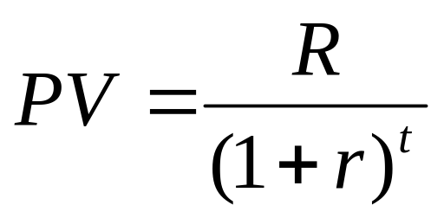
A P P E N D I X
CALCULATING PRESENT VALUE
PRESENT VALUE
present discounted value (PDV), or present value (PV) The present discounting value of R dollars to be paid t years in the future is the amount you need to pay today, at current interest rates, to ensure that you end up with R dollars t years from now. It is the current market value of receiving R dollars in t years.

Slide 44
What is the impact of an increase in the interest rate on present value?
a. A higher interest rate increases present value.
b. A higher interest rate decreases present value.
c. None. The interest rate is not a component of present value.
d. A higher interest rate makes the present value of an investment project more attractive.

Slide 45
What is the impact of an increase in the interest rate on present value?
a. A higher interest rate increases present value.
b. A higher interest rate decreases present value.
c. None. The interest rate is not a component of present value.
d. A higher interest rate makes the present value of an investment project more attractive.

Slide 46
A P P E N D I X
CALCULATING PRESENT VALUE
PRESENT VALUE
TABLE 11A.2 Calculation of Total Present Value of a Hypothetical Investment Project (Assuming r = 10 Percent)
END OF… | $(r) | DIVIDED BY (1 + r)^{t} | = | PRESENT VALUE ($)
Year 1 | 100 | (1.1) |  | 90.91
Year 2 | 100 | (1.1)² |  | 82.65
Year 3 | 400 | (1.1)³ |  | 300.53
Year 4 | 500 | (1.1)⁴ |  | 341.51
Year 5 | 500 | (1.1)⁵ |  | 310.46
Total Present Value |  |  |  | 1,126.06

Slide 47
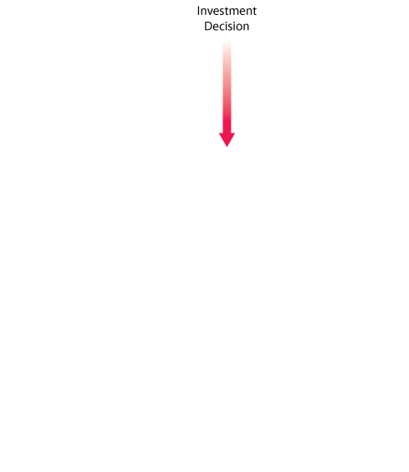
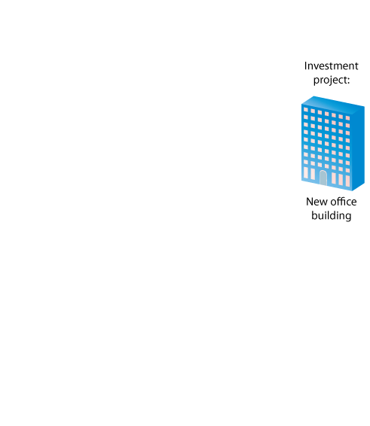


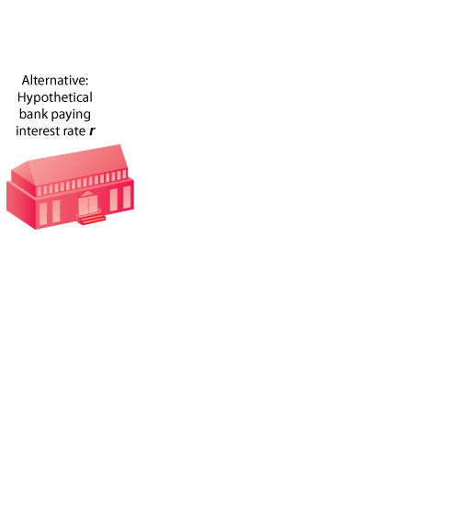


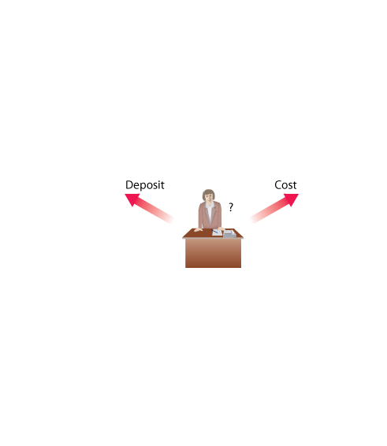
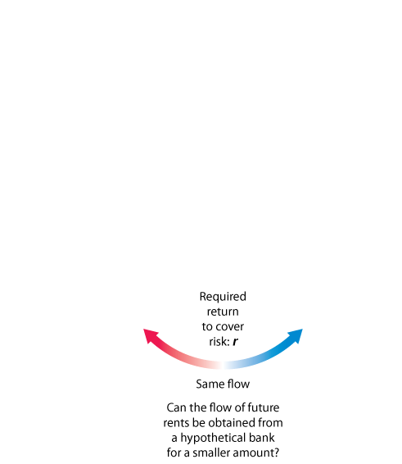
A P P E N D I X
CALCULATING PRESENT VALUE
PRESENT VALUE
④ FIGURE 11A.1 Investment Project: Go or No? A Thinking Map

Slide 48
A P P E N D I X
CALCULATING PRESENT VALUE
LOWER INTEREST RATES, HIGHER PRESENT VALUES
TABLE 11A.3 Calculation of Total Present Value of a Hypothetical Investment Project (Assuming r = 5 Percent)
END OF… | $ | DIVIDED BY (1 + r)^{t} | = | PRESENT VALUE ($)
Year 1 | 100 | (1.05) |  | 95.24
Year 2 | 100 | (1.05)² |  | 90.70
Year 3 | 400 | (1.05)³ |  | 345.54
Year 4 | 500 | (1.05)⁴ |  | 411.35
Year 5 | 500 | (1.05)⁵ |  | 391.76
Total Present Value |  |  |  | 1,334.59

Slide 49
A P P E N D I X
CALCULATING PRESENT VALUE
LOWER INTEREST RATES, HIGHER PRESENT VALUES
If the present value of an expected stream of earnings from an investment exceeds the cost of the investment necessary to undertake it, then the investment should be undertaken. However, if the present value of an expected stream of earnings falls short of the cost of the investment, then the financial market can generate the same stream of income for a smaller initial investment, and the investment should not be undertaken.

Slide 50
REVIEW TERMS AND CONCEPTS
present discounted value (PDV) or present value (PV)

